Slide 1
NACPO OVERVIEW & UPDATES
29 October 2013

Slide 2
Agenda
2013 Initiatives and Goals - Review
Questions

Slide 3

NA CPO Mission & Responsibilities
Product testing and certification
Staff technical competency with the PDE organization
Development and maintenance of certification requirements
Consistency in the application of certification requirements
Management of UL Product Certification Program
Notes:
Key Responsibilities
Provide direction, oversight, interpretation, guidance and counseling on a global basis to certification staff concerning UL certification policies, practices and procedures to ensure consistency, accuracy, engineering quality and technical integrity in providing certification services.
Provide direction and oversight to assure that test data and certification reports are technically appropriate and consistent through use of global forms.
Provide direction and oversight for qualification criteria.
Maintain North American Certification Programs Intranet website which includes information on staff technical competencies, new product categories, Industry File Review data
Provide direction to PDE organization including the development and implementation of certification requirements and program requirements.
Provide direction for acquiring and maintaining accreditation for UL's testing and certification services under the UL Mark Program.
Provide direction for UL's Industry File Review process involving Standards revisions having Effective Dates.
Provide direction for implementation of UL's Data Acceptance Program.
Develop/maintain UL Mark policy documents.
Chair the UL Mark Certification Policy Committee, which reviews and approves proposed revisions to UL Mark policy.

Slide 4

NA CPO Responsibilities - continued
Compatibility of certification requirements with applicable installation codes
Content of Certification Documentation on LIS
Data Acceptance Policy
Product Certification Program Management Office for all North American certifications provided by UL enterprise
Notes:
Key Responsibilities
Provide direction, oversight, interpretation, guidance and counseling on a global basis to certification staff concerning UL certification policies, practices and procedures to ensure consistency, accuracy, engineering quality and technical integrity in providing certification services.
Provide direction and oversight to assure that test data and certification reports are technically appropriate and consistent through use of global forms.
Provide direction and oversight for qualification criteria.
Maintain North American Certification Programs Intranet website which includes information on staff technical competencies, new product categories, Industry File Review data
Provide direction to PDE organization including the development and implementation of certification requirements and program requirements.
Provide direction for acquiring and maintaining accreditation for UL's testing and certification services under the UL Mark Program.
Provide direction for UL's Industry File Review process involving Standards revisions having Effective Dates.
Provide direction for implementation of UL's Data Acceptance Program.
Develop/maintain UL Mark policy documents.
Chair the UL Mark Certification Policy Committee, which reviews and approves proposed revisions to UL Mark policy.

Slide 5
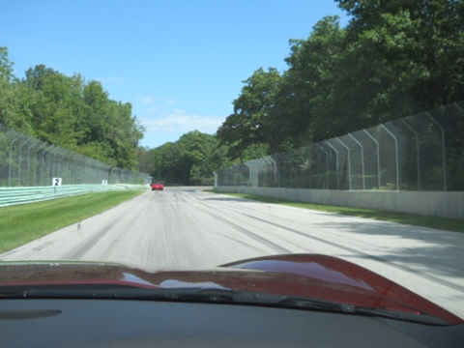
Ongoing Oversight of:
Data Acceptance Program
C-UL Certification Guidance
Construction Review Datasheets (CRDs)
UL-CSA MOU and Related Information
Acceptance of Components Certified by Others
New Product Categories
Products Ineligible for Certification
Complementary CCNs
Energy Verification Service (EVS)
Rebuilt Products
IFR Website
UL Marks
UL Mark Program Policy Documents
UL Mark Certification Program Training Modules
UL Mark Policy Announcement Bulletins (2008-present)
Provisional Certification
Notes:
NA CPO oversight to keep things going on the straight and narrow path.
To ensure consistency while maintaining an open mind to necessary change.

Slide 6

2013 Initiatives and Goals
Revisions to UL Mark Policy documents w.r.t. 17065/17025 Stds
Impartiality, Safeguard Mechanism – ISO 17065
Continuing Certification
Convergence of UL Mark and ULC Mark Programs
Transition Policy for Acquired Test Labs w.r.t 17025
Proactive Support of New Businesses and Business Units
Medical (L&HS) – Certification Process Redesign
VS – Diamond & OTC/Dietary Supplements
Notes:
UL Mark Policy Revisions w.r.t. 17065/17025 – (Rod & Jim)
UL Mark Training – (Jim) based on goal above
Impartiality Safeguard Mechanism – (Bill, Rod, Walt, Joe Taylor)
Convergence of UL Mark and ULC Mark Programs – (Mike)
Transition Policy for Acquired Test Lab w.r.t. 17025 – (Jim)
Proactive Support of New Businesses and BU’s – (BC and NACPO team)

Slide 7
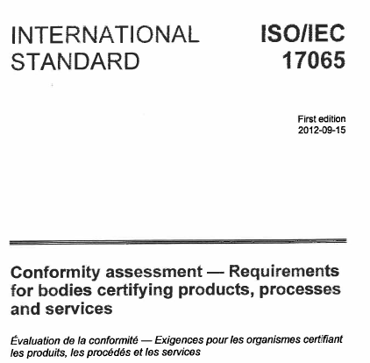
ISO/IEC 17065 Documentation
Drafting Revisions to UL Mark Policy Documents
to coincide with -
o 17065
o OSHA Regulations
o CAN-P-1500
Notes:
When these documents are adopted (2014 implementation), UL needs to assure policies and processes address the revised document. This goal is to assure CPO maintains involvement in the development of the internal documents and to track the comments presented by UL to the revisions with the purpose of having the least impact on UL’s policies, processes and requirements that are passed on to UL customers.
Draft documents have been created to define certification body (CB) requirements and to describe the UL Mark scheme. As a result of a meeting with Steve Margis and others on 8 Apr 2013, a task force was formed to further explore the structure of the various CBs and Schemes to address ISO/IEC 17065, with the direction being to create a global certification body manual that would describe all of the common approaches to compliance; individual certification body manuals would then be created to describe any differences in approach by the individual bodies. Suggestions from this task force were compiled and presented to Steve Margis for use at the AMR. Also, a meeting with the rest of NA CPO was held on 23 Apr 2013 to review the latest draft of the UL Mark Scheme document and the approach. Karina Christiansen was in RTP 18-21 June 2013 to draft a global certification body manual. This draft is being reviewed with CPO management.
Note that it is anticipated the changes to the top-level policy documents will have little impact on staff, as the existing SOPs will remain and the way projects are handled will not change. The only difference will be how the policy documents are structured, so as to align them with ISO/IEC 17065 in the same manner as they now align with ISO/IEC Guide 65.

Slide 8
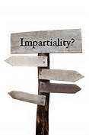
ISO/IEC 17065 Compliance with Impartiality Requirements
Risk identification and Mitigation
(a) Obsolete Consulting SOP 00-TC-S0026, and make revisions to other UL documents such as the Standards of Business Conduct to clearly indicate no consulting and ISO 17065 impartiality requirements
(b) Develop staff notification on Consulting/Impartiality issues, e.g. Bulletin to staff ;
(c) Develop on-line Impartiality training via Corpedia.
Notes:
The decision was made at the AMR that UL will not offer design consulting, and thus the organizational scenario involving a separate legal entity will not be necessary. Diagrams showing how the various UL certification bodies might address ISO/IEC 17065 clauses 4.2 and 5.2 have been developed and are being reviewed. SOPs and other tools used by Life & Health Sciences to address impartiality for their activities governed by ISO/IEC 17021 (similar requirements as ISO/IEC 17065) have been received from Mark vandeWaterlaat, and are being reviewed for applicability to the certification bodies in the UL family of companies. Several options for the format of the "mechanism" have been brainstormed, including: expanding the scope of the existing Engineering and Advisory Councils to include the review of identified risks to impartiality; creating a new Council specifically tasked with functioning as this mechanism (similar to what Life & Health Sciences as done for ISO/IEC 17021); creating a collaboration site that would be accessible by outside stakeholders, where risk identification and mitigation activities would be provided for review and comment; or, creating a blog, similar to the collaboration site. These ideas are being further discussed with CPO management.

Slide 9
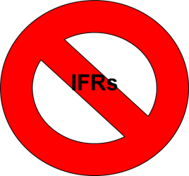
Continuing Certification
Continuing Certification Approach (IFR Kaizen)
Goal of achieving Reduced IFRs
– “Pilots” initiated in select Standard(s) → positive feedback
– SOPs, Training and IT-related systems enhancements near completion
– UL Standards only, including Harmonized Standards
Staff announcement on rollout to be issued shortly.
Notes:
<>In 2012, major efforts to refine and finalize the “Continued Certification Approach” proposal. The IFR Kaizen Team led by Mike Jorgenson, has been working on a number of actions to initiate pilots for some categories. Pilots have been initiated for UL873/UL60730 (Temp Controllers), UL1640 (Port Power Distribution Panels), UL758 (AWM). For the most part, the approach is limited to UL Standards only, i.e. no CSA, NSF or other non-UL Standards. Traditional IFR approach will continue to be an option.
The Continuing Certification pilot has met with success in that it has resulted in the avoidance of Industry File Reviews in 100% of the situations where the ballot was presented to the STP. This was the goal of the effort. The team has been working diligently to move this from a pilot to a production process. Some work-arounds were necessary as some of the enhancements to the IFR database were delayed due to other corporate initiatives involving IT resources. The core leadership team members in this effort have been most supportive. Refinements to the process resulted in delays in finalization of the documentation for the pilot along with training. While the training was completed and sent to ULU, the training development effort was suspended due to last-minute changes in the process. The team has completed the program documentation, the training is near completion, and the staff announcement is being prepared for a September distribution.

Slide 10



UL and ULC Mark Programs Alignment
Program Policies
ULC Mark Categories – PDE Correlation
CCN = ABCD
CCN = ABCDC
Notes:
Program Policies – UL Canadian offices has not fully been integrated into the UL policies and processes. In certain instances, Canadian regulations prevent identical requirements; however, there may be those where it is not be necessary to have differences. The goal is to identify those questionable areas and propose revisions to UL and ULC policies to better align business practices, as well as to capture the rationale for the differences where required. This effort is a continuation of a plan to align UL and ULC policies and practices. The plan involved aligning ULC policy with UL policy starting with the requirements in ISO/IEC Guide 65. This effort was initiated, but shortly after work began, it was agreed that the effort to align these policies with Guide 65 would be fruitless recognizing that ISO/IEC 17065 was soon to be published and it was decided that 17065 would be used as the guide for alignment. This effort will be integrated with the transition from Guide 65 to 17065 and will continue into next year.
PDE Category Correlation - Significant progress has been made in adding names of PDEs that are responsible for ULC CCNs. Three PDE Managers have assigned UL PDEs in categories for Fire Extinguishers, Fire Alarm Control Units, Flame, Smoke Detectors, Fuel Tanks, Fire Alarm Systems, Burglar Alarm Systems, Extinguishing Systems, Fire Dampers, Roofing, Building Materials and Assemblies, Fire Resistance – Fabrics and Films, Hose Couplings, Emergency Exit Hardware, Fire Doors, Door Closers, Firestop Systems, and Building Construction and Materials. More categories need to be assigned and work will continue to align the categories with a specific PDE.

Slide 11

Acquired Labs & BU Collaboration
Transition Policy for Acquired Test Labs w.r.t 17025
Proactive Support of New Businesses and Business Units
Medical (L&HS) – Certification Process Redesign
VS – Diamond & OTC/Dietary Supplements
Notes:
Transition Policy for Acquired Test Labs w.r.t. 17025 – An “Acquired Test Laboratory Data Program” document was developed to establish a standard operating procedure that details how laboratories that have been a participant under the Third Party Test Data Program and that are subsequently acquired by UL enter into and maintain participation in the Acquired Test Laboratory Data Program. While the document was being circulated the decision was made to handle all laboratories owned by UL, whether acquired or not, in a similar manner. This resulted in the effort being developed as part of the GTLP to TCLP transition.
Proactive Support of New Businesses and Business Units - (a) Assisting Jack Steiner in development of Pilot SOP Anticipate pilot to be initiated in Q4 2013 in conjunction with ARIA launch (b) Assisting VS in evaluating existing programs/service in order to establish them as certification programs. The potential certification programs include (a) Jewelry/Diamond certification, (b) Non-GMO certification, (c) Dietary Supplements certification, and (d) Food Contact Substance certification. Feasibility of establishing certification programs is underway along with defining program scope and deliverables. VS and CPO sponsors determined Jewelry/Diamond and the OTC/Dietary Supplements projects were in the best position to proceed in establishing programs. Respective teams have been formed and client “partners” have been identified along with determining the essential tasks in developing these programs. The OTC/Dietary project is anticipated to be available in Q4 2013 while the Jewelry/Diamond project is anticipated to be launched in Q1 2014. .

Slide 12
Annual Management Review
Global Annual Management Review
Compliance with relevant international guides
ISO/IEC Guide 65, ISO/IEC 17065
Supporting guides (e.g. ISO/IEC 17025, ISO/IEC 17020)
Compliance with accreditor / program specific requirements
Drive consistency between programs
Drive cross functional understanding of issues
Drive issues to resolution
Obtain commitment from involved functions
Notes:
NA CPO collects informatio0n and interviews Program Owners to ensure adequacy of the following items. The resulting key issues are presented during the Annual Management Review meeting with the Corporate Review Committee, consisting of UL Leadership.
Suitability of policies and procedures
Reports from managerial and supervisory personnel
Outcome of recent internal audits
Corrective and preventive actions
Assessments by external bodies
Results of interlaboratory comparisons or proficiency tests
Changes in the volume and type of the work
Customer feedback
Complaints
Recommendations for improvement
Other relevant factors
Quality control activities
Resources
Staff training.

Slide 13
THANK YOU.
Questions…

Slide 14
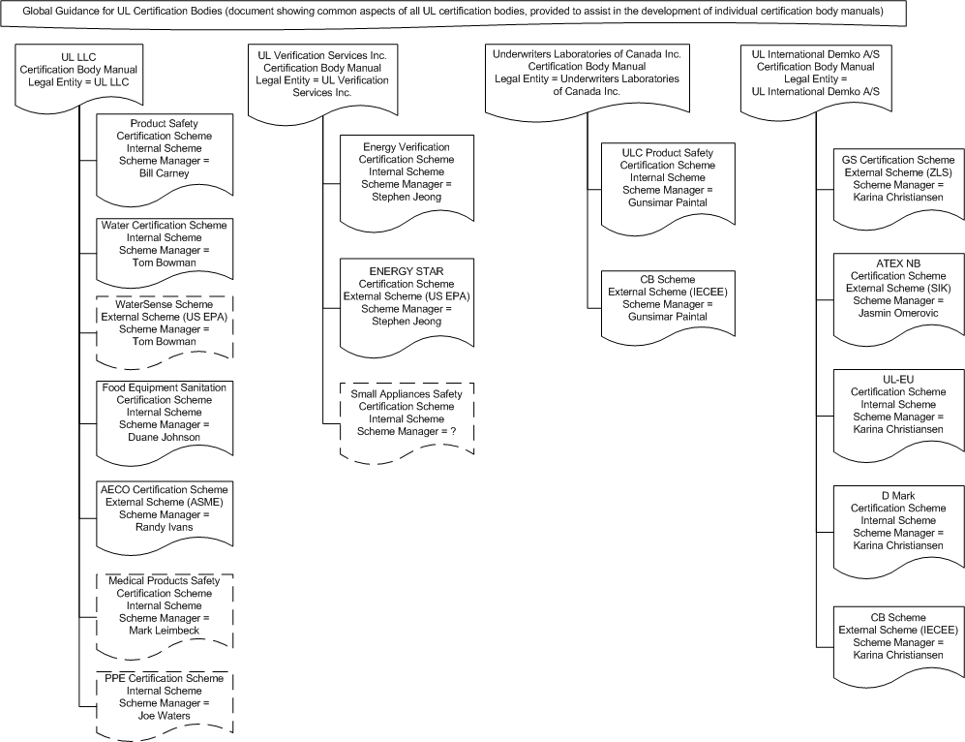
17065 Document Structure

Slide 15
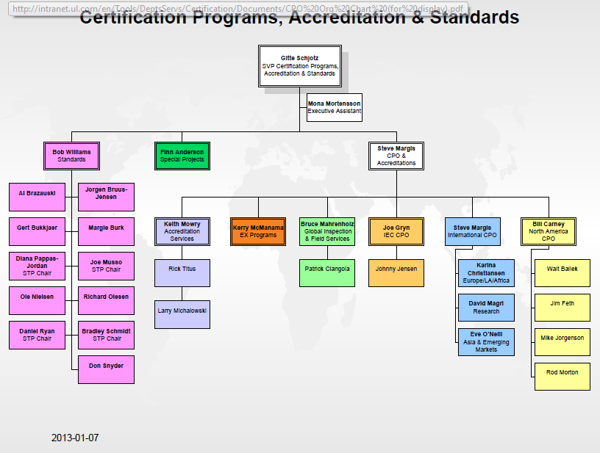
NACPO - ORGANIZATION

Slide 16
NA CPO – Organization, continued
William Carney
Global Chief Engineer
NA CPO
Michael Jorgenson
Program Manager
USA & Canada
Jim Feth
Program Manager
Asia
Rod Morton
Program Manager
UL Mark Policy Documentation
Walt Ballek
Program Manager
EULA
Notes:
NA CPO staff members and key responsibilities.

